Slide 1



STANDARD CHARTERED GBS DIVERSITY HACKATHON -2024
FRAUD DETECTION MODEL USING AI
TEAM -02:
RAKSHITA UPADHYAY
HARINI JAYKUMAR
MANVI HARITWAL
SUPRABHA DESAI BOJJA
UDDARAJU VIJAYA LAKSHMI ANANYA

Slide 2
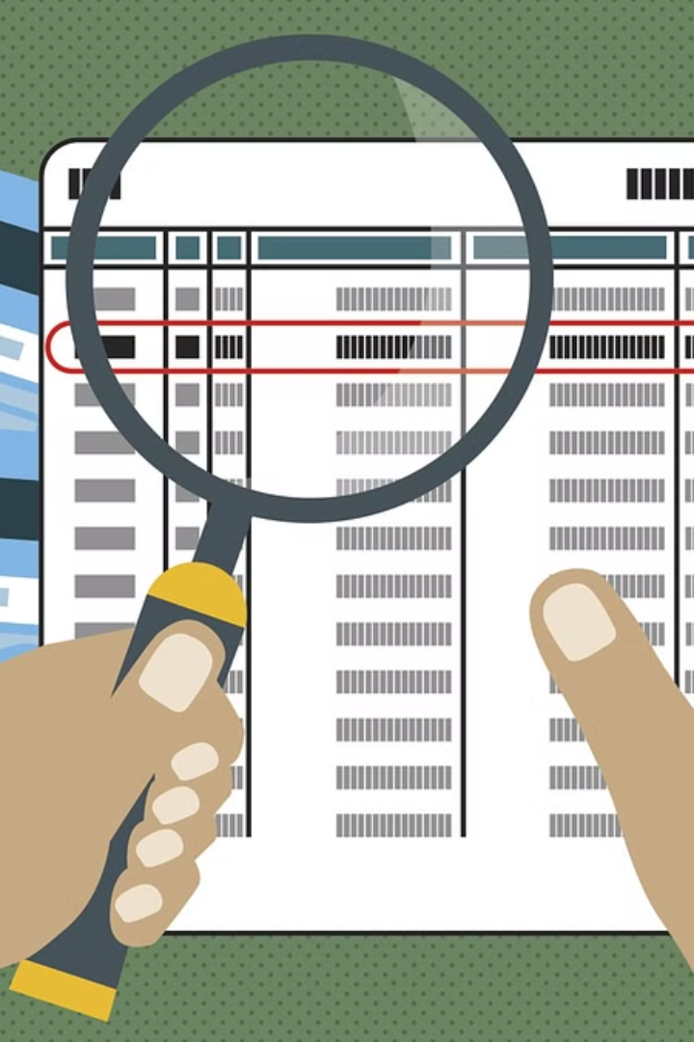
Fraud Detection model using AI
In today's digital age, fraudsters are becoming more sophisticated in their methods. Our Fraud Detection model leverages the power of Artificial Intelligence to detect and prevent fraudulent activities in real-time. By analyzing large amounts of data and identifying patterns, our AI-powered solution provides accurate and timely fraud alerts, helping businesses protect themselves and their customers from financial losses.

Slide 3
Common types of financial fraud
Identity Theft
Insurance Fraud
A fraudulent acquisition and use of an individual's personal information for financial gain.
Falsifying or exaggerating insurance claims to obtain undeserved funds.
Embezzlement
Credit Card Fraud
Illegal misappropriation of funds by a person entrusted to manage or monitor them.
Unauthorized use of someone else's credit card information to make purchases.
The impact of financial fraud on businesses and individuals
Financial Loss
Reputation Damage
Businesses and individuals suffer significant financial losses due to fraud, leading to reduced resources and opportunities for growth.
Fraud can tarnish the reputation of businesses and individuals, impacting trust and credibility in the market.
Emotional Distress
Legal Consequences
Victims of financial fraud experience emotional distress, anxiety, and stress, affecting their well-being and mental health.
Financial fraud can result in legal battles, litigation costs, and damage to personal and professional relationships.

Slide 4
Limitations of traditional methods
Lack of Real-time Monitoring
Difficulty in Adapting to New Schemes
High False Positive Rates
Manual review processes can result in a high volume of false positives, leading to wasted resources.
Traditional methods often rely on batch processing, leading to delayed detection of fraudulent activities.
Traditional methods struggle to keep up with the evolving tactics and strategies of fraudsters.

Slide 5



Machine learning and artificial intelligence in fraud detection
Data Analysis
Predictive Modeling
Real-time Monitoring
AI processes large volumes of data to identify patterns and anomalies.
Machine learning algorithms forecast potential fraudulent activities based on historical data.
Smart technology enables continuous monitoring for immediate detection of suspicious transactions.

Slide 6
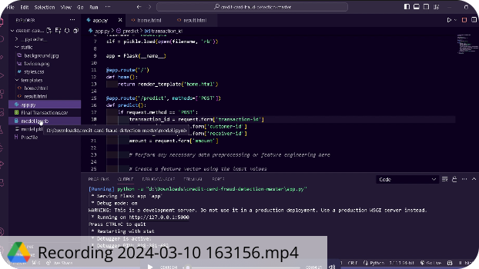
Demo Video of the Project:

Slide 7


Slide 8

Technologies Incorporated:
Framework : Python Flask
Front-End : HTML , CSS , JS
ML Prediction Model : Random Forest Method (Python)
(Compared 3 different model - Logistic Regression, XGBoost and Random Forest wherein Random forest gave the best accuracy)
Training and Testing : Google Colab
(https://colab.research.google.com/drive/1mnoKEN5wmvf0uZxx2guhtPKAUTuVSiPW?usp=sharing )
Dataset : Kaggle

Slide 9
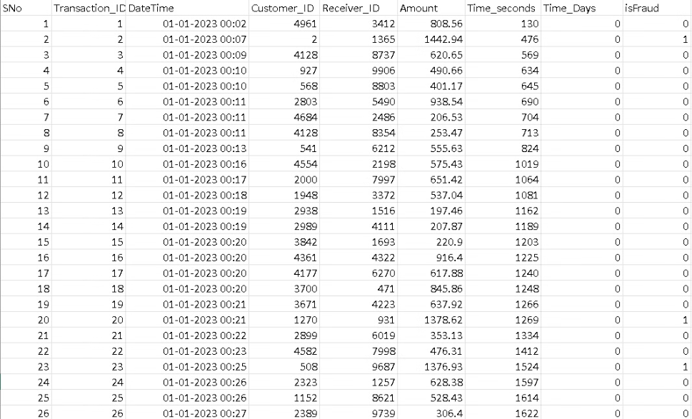
DATASET:
The dataset consists of 1.75 million transactions made by considering simulated users through various terminals throughout the period from January 2023 to June 2023. It marks the transaction with high amount of money and multiple transactions by the same user within a small timeframe as fraudulent.

Slide 10

Features and Labels
Features:
→ Transaction_id → Customer_id → Receiver_id →Amount
Labels / Class variable:
→ isFraud
* It takes up the value of either 0 (or) 1 .
* 0 indicating not fraudulent and 1 indicating fraudulent transaction.

Slide 11

Use- Case of the Model
The prediction model built is used to detect an anomaly change in data pattern i.e whenever there's a relatively high amount transfer it classifies as fraudulent transaction otherwise non-fraudulent.
Here, in rows 20 and 23 , there's a significant change in amount feature than rows 21, 22 ; Thus the former are classified as fraudulent.

Slide 12
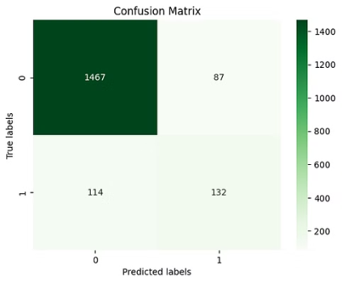
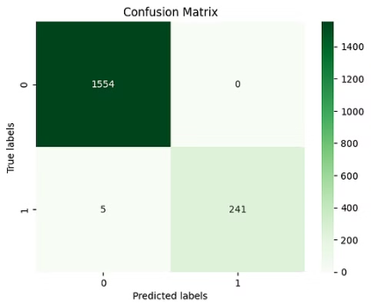
Comparing the Machine Learning Algorithms
Logistic Regression Random Forest XGBoost
Accuracy: 88% 99.72% 99.55%

Slide 13
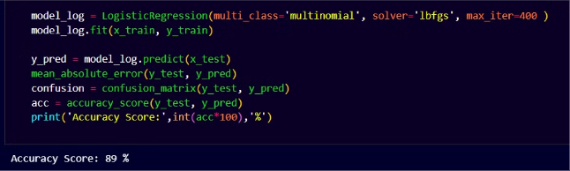
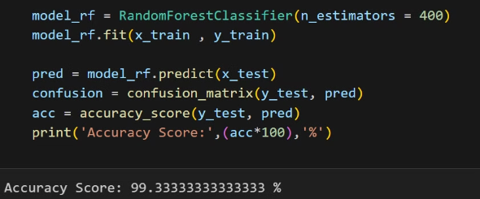
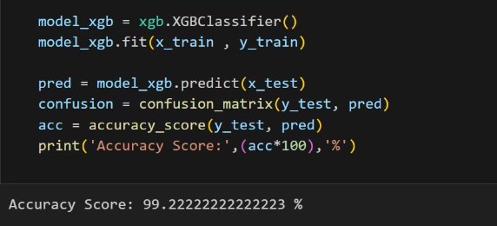
Logistical Regression
Random Forest Classifier
XGB Classifier

Slide 14
Why Random Forest?
Accuracy: The random forest model achieved a high accuracy score of 99.72%, indicating strong predictive performance on the dataset.
Ensemble Advantage: Random forests have the advantage of being an ensemble model, combining the predictions of multiple decision trees. This often leads to improved generalization and robustness compared to individual models like logistic regression.
Overfitting Mitigation: Random forests are less prone to overfitting compared to complex models like XGBoost. This is evident from the accuracy scores, where the random forest outperformed XGBoost, suggesting that the former may have a better balance between bias and variance.
Confusion Matrix Comparison: The confusion matrix provides insights into the model's performance, especially in terms of precision, recall, and F1 score for each class. If the random forest also exhibited better performance in terms of these metrics, it would further support its selection.

Slide 15
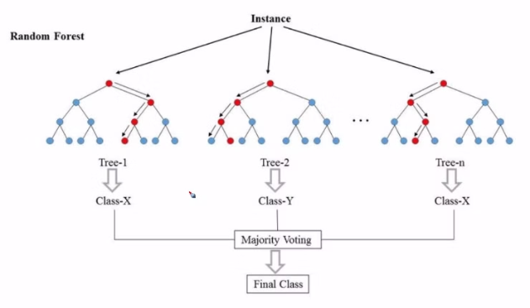
Random Forest - Machine learning Approach
Random Forest is an ensemble learning method used in machine learning for both classification and regression tasks. It constructs a multitude of decision trees during training and outputs the mode (for classification) or average prediction (for regression) of the individual trees.
The key idea is to introduce randomness at two levels: by using a random subset of the training data to build each tree (bagging), and by considering only a random subset of features at each split in the decision tree. This randomness helps prevent overfitting and improves the model's robustness and accuracy.
The final prediction is a combination of the predictions from all the individual trees, resulting in a powerful and versatile algorithm suitable for a wide range of applications.

Slide 16

Conclusion and Future
The fraud detection model has high accuracy and effectively identifies fraud, enhancing security. Continuous monitoring and updates are needed to keep up with evolving fraud patterns. This model is a strong foundation for securing financial transactions, but ongoing vigilance and improvements are necessary to stay ahead of emerging threats.
Future efforts should improve the model's ability to detect new fraud methods by training it regularly with up-to-date data. Implementing advanced anomaly detection techniques and real-time monitoring can strengthen the system even more. Working with industry experts and incorporating cutting-edge technologies like deep learning or blockchain can add extra security layers. Moreover, enhancing interpretability, trust, and expanding the model's use across different industries are important research directions for reinforcing fraud detection methods.

